Slide 1
Appositives and Appositive Phrases
They modify and describe!

Slide 3
Appositives…
are a noun or pronoun.
are placed beside another noun or pronoun to identify or describe it.
give us extra information about the noun or pronoun.

Slide 4
Example of an Appositive
For example: The doctor, Jimmy Stabb, was the most confident person I ever knew.
Jimmy Stabb is a noun.
It’s modifying the noun “doctor.”
It’s placed beside the noun it is modifying.
And it gives us extra information.

Slide 5
An appositive phrase…
is a noun or noun phrase added to a sentence that redefines or clarifies the subject.
gives additional information or meaning that is nonessential.
can be added to, or removed from, a sentence without affecting the syntax of the sentence.
Notes:
Is an appositive and its modifiers
does not change the grammar of the original sentence.

Slide 6
Example of an Appositive Phrase
Leonardo da Vinci, an Italian painter known for his artworks, was also an architect, engineer, and scientist.
APPOSITIVE PHRASE:, an Italian painter known for his artworks,
WITHOUT THE APPOSITIVE PHRASE:
Leonardo da Vinci was also an architect, engineer, and scientist.

Slide 7
Appositive Phrases
When nonessential information is added to a sentence using an appositive expression, it is usually separated from the main sentence using commas.
At the beginning of a sentence: _______ ,
In the middle of a sentence: , _______ ,
At the end of a sentence: , _______ .

Slide 8
Appositive Phrases
Examples in the middle of a sentence:
Riley, the police officer, took the highway to save time.
WITHOUT APPOSITIVE: Riley took the highway to save time.
Queen Elizabeth, who rules England, is a well-known monarch.
WITHOUT APPOSITIVE: Queen Elizabeth is a well-known monarch.
Sweetwaters, a nearby coffee shop, is always packed.
WITHOUT APPOSITIVE: Sweetwaters is always packed.

Slide 9
Write your own sentence with an appositive phrase!
Notes:
Prone to road rage, Aleesa has always hated traffic jams.
Aleesa, prone to road rage, has always hated traffic hams.
You may get along with Aleesa, a friend of mine who is also prone to road rage and hates traffic jams.

Slide 10
Appositive Phrases
Examples at the end of a sentence:
Meghan was talking to Carla, her childhood friend.
WITHOUT APPOSITIVE: Meghan was talking to Carla.
She owed Aniket a free bubble tea, his favorite drink.
WITHOUT APPOSITIVE: She owed Aniket a free bubble tea.
The homework was due on Tuesday, my busiest day unfortunately.
WITHOUT APPOSITIVE: The homework was due on Tuesday.

Slide 11
Write your own sentence with an appositive phrase!
Notes:
Longing for some time alone, Jillian finally found a place to reflect.
Jillian, a lovely poet, needed some time away from people to do her best work.
That morning I could finally watch the sun rise, my way of remembering that I am small and finite.

Slide 12
Appositive Phrases
Examples at the beginning of a sentence:
A man with a hard heart, Okeke refused to see his son.
WITHOUT APPOSITIVE: Okeke refused to see his son.
The city I call home, Detroit has a fascinating history.
WITHOUT APPOSITIVE: Detroit has a fascinating history.
A laid back guy, Davey never lost his cool.
WITHOUT APPOSITIVE: Davey never lost his cool.

Slide 13
Write your own sentence with an appositive phrase!
Notes:
The sweet puppy, soft as a cloud, ran towards me excitedly.
Bean ran towards Missy, her new owner.
Quick like lightning, Bean chased after the chipmunk.

Slide 14
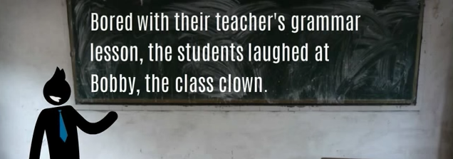
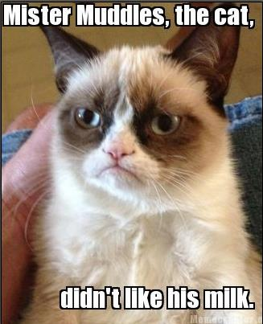

Slide 15
Side Note on Appositives
**If the appositive is set off by commas, that means we don’t really need it in the sentence to complete the meaning and it can be taken out.
Example: My mom, Maria, volunteers at the community garden.
**If the appositive does not have any commas around it, we NEED it in the sentence to complete the meaning.
Example: The book Catcher in the Rye is his favorite novel.

